Slide 1
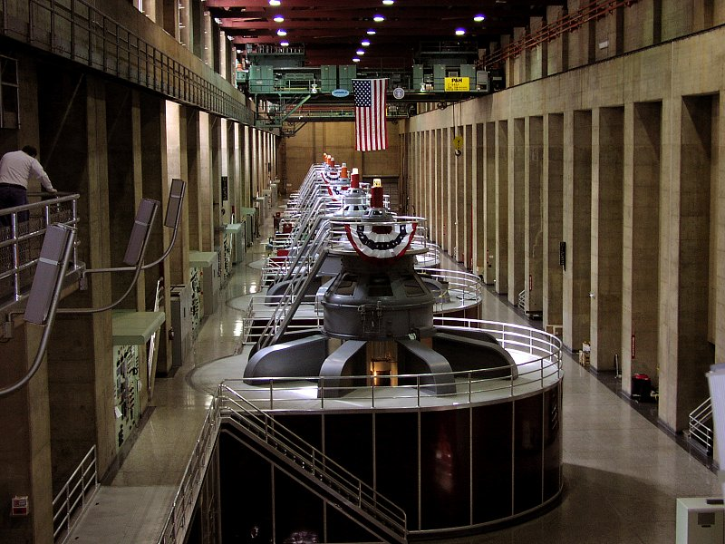

Inducing e.m.f and Current Generating Electricity

Slide 2
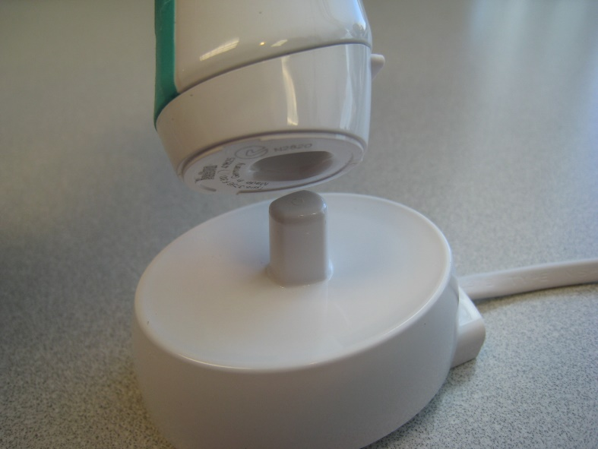


Changing Flux and Conductors
Faradays Law and Induced e.m.f
Lenz’s Law

Slide 3
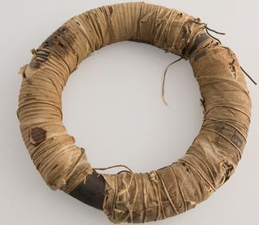
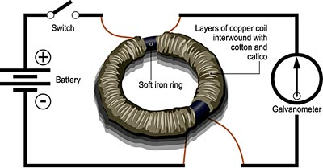
The Motor Effect in Reverse ?
After the discovery that an electric current produces a magnetic field, Michael Faraday was convinced that a Magnetic field should then also be able to produce an electric current.
He experimented with a coil similar to those shown to the right.

Slide 4
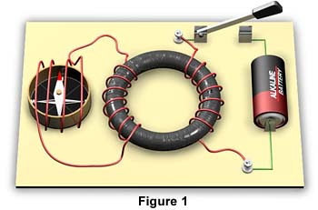
The Motor Effect in Reverse
Faraday thought that the magnetic field created in the primary coil (right) would pass through the soft iron ring to the secondary coil and produce current in the second coil (middle left).
The coil with the compass in it was designed to detect current that might flow (as its magnetic field produced by the induced current should deflect the compass).
compass
secondary coil
primary coil

Slide 5
Disappointing results ☹
Faraday’s results were at first disappointing. It appeared that whilst the circuit was on, no current was induced in the secondary coil.
One day Faraday noticed that when he switched on the primary coil there was a spike of current in the secondary coil which stopped almost instantly.
The same thing occurred when he switched it off but in the opposite direction!
secondary coil
primary coil

Slide 6
Electromagnetic Induction Using a Magnet
What happens when a magnet is moved in and out of the coil? (Watch the meter!)
What does changing direction do?
What happens if the magnet is still?
Does changing the speed of movement have any effect?
μA

Slide 7
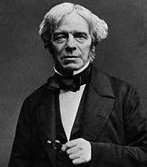
Faraday’s Observations with Magnets
A current is produced in the wire only when the magnet is moving.
N
A
S

Slide 8
Faraday’s Observations with Magnets
The faster the magnet moves, the bigger the current.
N
A
S

Slide 9
Faraday’s Observations with Magnets
The stronger the magnet, the bigger the current.
N
A
S

Slide 10
Faraday’s Observations with Magnets
The more turns on the coil (same area), the bigger the current.
N
A
S

Slide 11
Faraday’s Observations with Magnets
The bigger the area of the coil, the bigger the current.
N
A
S

Slide 12
Faraday’s Observations with Magnets
If the movement is not perpendicular, the current is less.
N
A
S

Slide 13
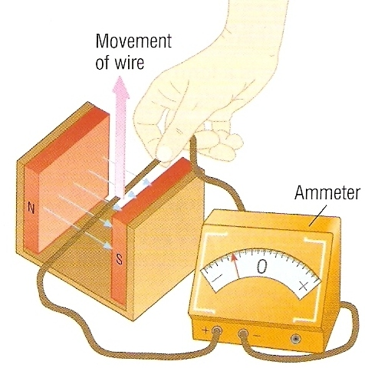
Electromagnetic induction
If an electrical conductor cuts through magnetic field lines, a voltage is induced across the ends of the conductor.
If the wire is part of a complete circuit, a current is induced in the wire.
This is called electromagnetic induction and is sometimes called the generator or dynamo effect.

Slide 14
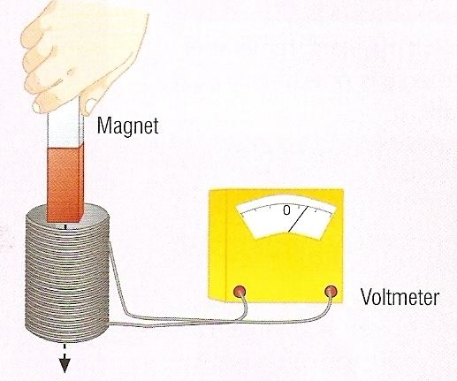
Electromagnetic induction also occurs if the magnetic field is stationary and the coil is moved.
There only needs to be relative motion between the coil and the electric field for an e.m.f to be induced!

Slide 15
Faraday’s law (at last!)
Did you know that I built the first electric motor and generator too?
I refused all prizes and awards because I believed that would detract from God’s glory.
As we have seen, an e.m.f. is only induced when the field is changing.
The induced e.m.f is found using Faraday’s law, which uses the idea of flux.

Slide 16
Faraday’s law
Hang on … What is magnetic flux? Ф
The induced e.m.f. is equal to the (negative) rate of change of magnetic flux,
e.m.f = -ΔФ
Δt

Slide 17
Magnetic Flux (Ф)
Imagine a loop of (plane) wire in a region where the magnetic field (B) is constant.
The field lines are referred to as lines of flux.
B

Slide 18
Magnetic Flux (Ф)
It can help to imagine the flux as the number of lines of magnetic field going through the area of the coil.
B

Slide 19


Magnetic Flux Density (B)
The magnetic field strength or “flux density” is therefore equivalent to the number of lines of magnetic field per unit area of the coil.
B
$$B=\frac{ϕ}{A}$$
$$ϕ=BA$$

Slide 20
The magnetic flux (Ф) is defined as Ф = BA cosθ
where A is the area of the loop ,θ is the angle between the magnetic field direction and the direction normal (perpendicular) to the plane of the coil.
B

Slide 21
If the loop has N turns, the flux is given by
Ф = N BA cosθ in which case we call this the flux linkage.
B
The unit of flux is the Weber (Wb) (= 1 Tm²)

Slide 22
We can increase the TOTAL flux with a larger area, a stronger field, and keeping the loop perpendicular to the field.
B
Ф = BA cosθ

Slide 23
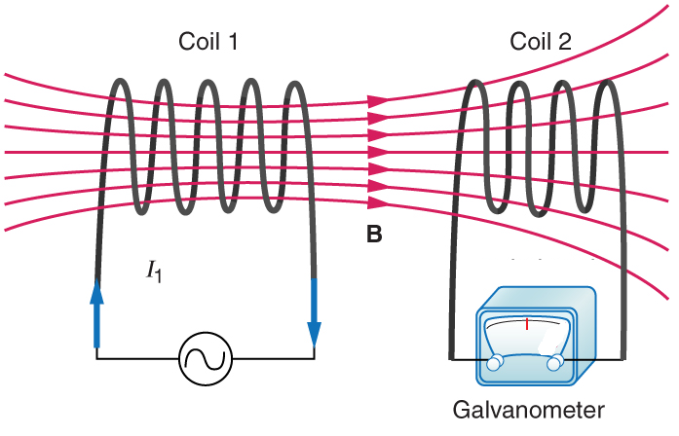
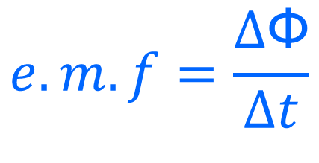
Faraday’s law
This relative motion or “change in flux” induces an e.m.f as the flux reduces to zero.
If the magnetic field from a solenoid passes through a second conductor, it does not induce current while the field is stable because there is
no change in flux.
If the solenoid is turned off, the field does not vanish instantly, but instead shrinks back before becoming zero again.
$$e.m.f=\frac{∆\text{Ф}}{∆t}$$

Slide 24
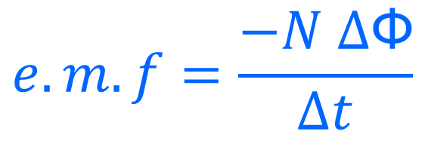
Faraday’s law
If coil 1 produces a field of 25.25 mT when stable but reduces to zero in 0.10 milliseconds, What e.m.f will be induced in the second coil as this occurs? The second coil has 4 turns and a diameter of 10cm.
$$e.m.f=\frac{−N ∆\text{Ф}}{∆t}$$

Slide 25

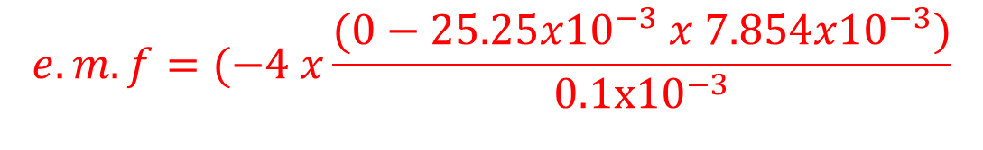
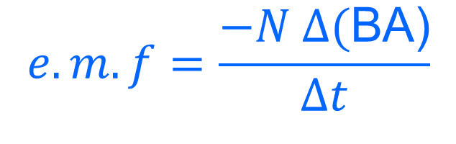
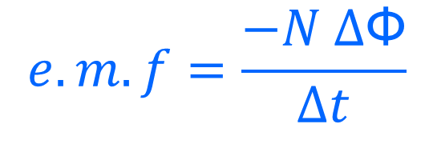
Faraday’s law
If coil 1 produces a field of 25.25 mT when stable but reduces to zero in 0.10 milliseconds, What e.m.f will be induced in the second coil as this occurs? The second coil has 4 turns and a diameter of 10cm.
$$e.m.f=\frac{−N ∆\text{Ф}}{∆t}$$
$$e.m.f=\frac{−N ∆\text{(}\text{BA}\text{)}}{∆t}$$
B₁ = 25.25 x10⁻³ T
B₂ = 0 T
D = 0.1m r = 0.05m
t = 0.1 x10⁻³ s
N = 4
A = π r² = π 0.05² = 7.854 x10⁻³ m²
$$e.m.f=(−4 x\frac{(0−25.25x{10}^{−3} x 7.854x{10}^{−3})}{0.1x{10}^{−3}}$$
$$e.m.f=7.93 V$$

Slide 26

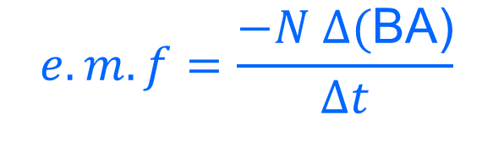
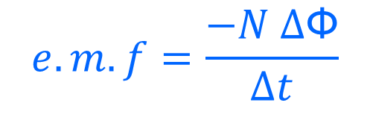
Faraday’s law
If coil 1 produces a field of 25.25 mT when stable but is REVERSED in 0.1 milliseconds when current is reversed, What e.m.f will be induced in the second coil as this occurs? The second coil has 4 turns and a diameter of 10cm.
$$e.m.f=\frac{−N ∆\text{Ф}}{∆t}$$
$$e.m.f=\frac{−N ∆\text{(}\text{BA}\text{)}}{∆t}$$
B₁ = 25.25 x10⁻³ T
B₂ = -25.25 x10⁻³ T
D = 0.1m r = 0.05m
t = 0.10 x10⁻³ s
N = 4
A = π r² = π 0.05² = 7.854 x10⁻³ m²
$$e.m.f=(−4 x\frac{(−25.25x{10}^{−3} x 7.854x{10}^{−3}−25.25x{10}^{−3} x 7.854x{10}^{−3})}{0.1x{10}^{−3}}$$
How does this value compare to the previous answer? Why?
$$e.m.f=15.9V$$

Slide 27
Electromagnetic Induction
Imagine a wire moving with velocity v in a magnetic field B out of the page.
Wire moving with velocity v
L
v
Region of magnetic field B out of page

Slide 28
The electrons in the wire feel a force (the motor effect) which pushes the electrons to the right. This is what creates a potential difference in the wire. We will discuss how we know which direction later in this presentation
L
Electrons pushed this way
v
Region of magnetic field B out of page

Slide 29
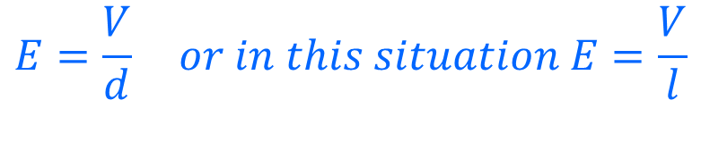
The field in the wire that produces this potential difference is given by
$$E=\frac{V}{d} or in this situation E=\frac{V}{l}$$
e.m.f. (voltage) across the wire in the magnetic field
+
L
-
v
Region of magnetic field B out of page

Slide 30
The force produced by this field E = V/L would push the electrons back again, but this is opposed by the force on the electrons due to the magnetic field F = qvB →This is an action - reaction pair
+
L
-
v
Region of magnetic field B out of page

Slide 31

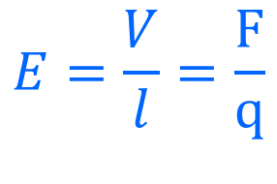
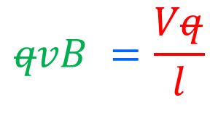


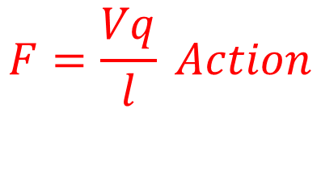

$$E=\frac{V}{l}=\frac{F}{q}$$
$$F=\frac{Vq}{l} Action$$
$$Reaction qvB =\frac{Vq}{l} Action$$
$$F=qvB Reaction$$
$$qvB =\frac{Vq}{l}$$
L
$$lvB =V$$
v
Region of magnetic field B out of page
$$e.m.f=lvB$$

Slide 32
This means that a conducting wire of length l moving with speed v normally to a magnetic field B will have a e.m.f. of lvB across its ends.
Wire moving with velocity v
L
v
Region of magnetic field B out of page

Slide 33
Another example question!
There is a uniform magnetic field B = 0.40 T out of the page. A rod of length l = 0.20 m is placed on a railing and pushed to the right at a constant speed of v = 0.60 m.s⁻¹. What is the e.m.f. induced in the loop?
L
v

Slide 34
The area of the loop is decreasing, so the flux (BAcosθ) must be changing. In time Δt the rod will move a distance vΔt, so the area will decrease by an area of lvΔt
l = 0.20 m
v = 0.60 m.s⁻¹
B = 0.40 T
l
v
lvΔt

Slide 35
e.m.f = ΔФ = BΔA = BlvΔt = lvB
Δt Δt Δt
e.m.f = 0.20 x 0.60 x 0.40 x = 4.8 x10⁻⁴ V
This proves that the two equations are equivalent!
l = 0.20 m
v = 0.60 m.s⁻¹
B = 0.40 T
L
v
LvΔt

Slide 36
Lenz’s Law
The induced current will be in such a direction as to oppose the change in magnetic flux that created the current
When Current is induced in a conductor by movement though a pre-existing magnetic field,
it will have its own (weaker) magnetic field.
The direction of current induced is such that its own magnetic field will oppose the motion through the preexisting magnetic field.

Slide 37
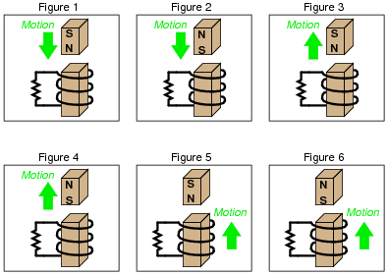
Predict the Direction of Current Induced
If a magnet if moved towards or away from a coil, the direction of induced current will be such that the coil becomes an electromagnet with a field that opposes the motion of the magnet.
N
S
S
N
N
S

Slide 38
Remember the moving wire?
Can we use a hand rule to work out direction of current?
L
v
Region of magnetic field B out of page

Slide 39
According to Lenz’s law, the current induced in the wire must produce a magnetic field and force that opposes the motion.
Which direction does the induced force need to be in?
L
F
v
Region of magnetic field B out of page

Slide 40
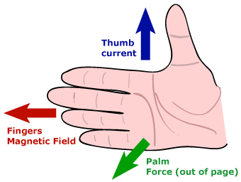
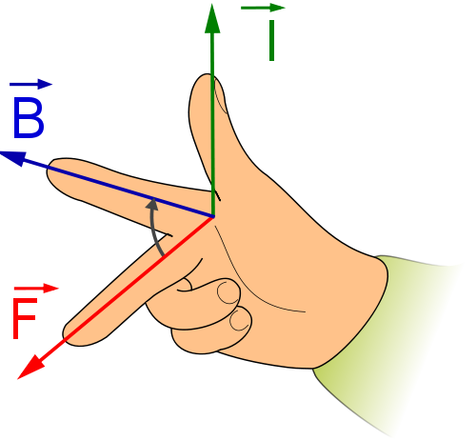
Using the right hand FBI rule or Palm rule, which direction does current have to be in to produce this force?
L
I
F
Electrons pushed this way
v
Region of magnetic field B out of page

Slide 41
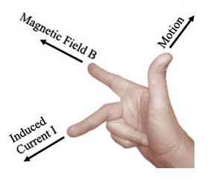
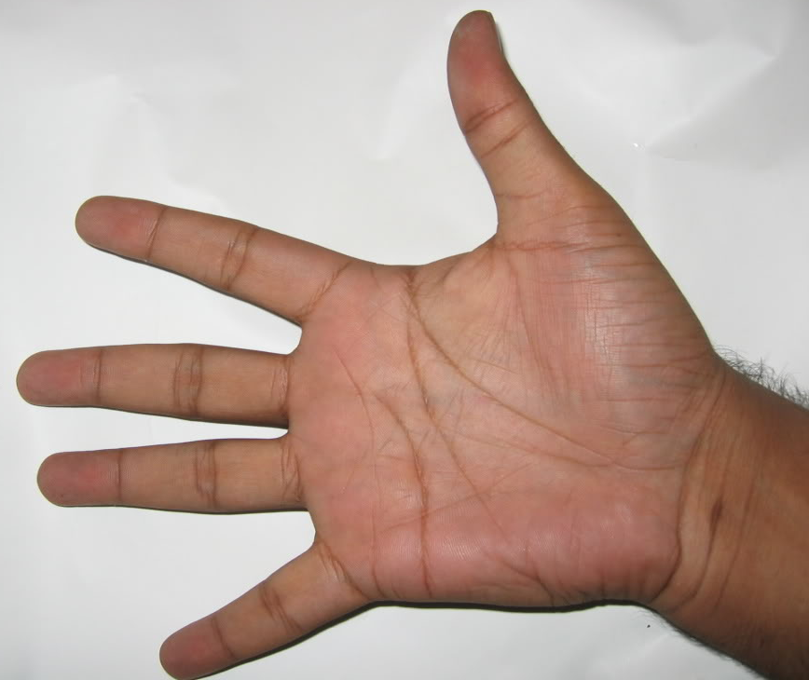
A New Hand Rule?
Which hand rule you use is not important.
What is important is that you use one you will remember!
I
M
B

